Slide 1
CSE 12 – Basic Data Structures and Object-Oriented Design Lecture 22
Greg Miranda & Paul Cao, Winter 2021
This lecture is being recorded

Slide 2
Announcements
Quiz 22 due Friday @ 8am
Survey 9 due Friday @ 11:59pm
PA8 due Thursday, March 11 @ 11:59pm

Slide 3
Topics
Streams
Questions on Lecture 22?

Slide 4
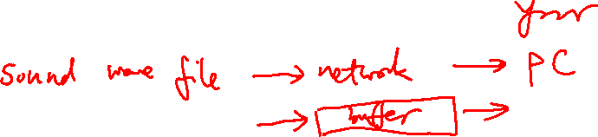
Stream
Normally used to connect source and your program
source → input stream → program → output stream → destination
Why do we need streams?

Slide 5
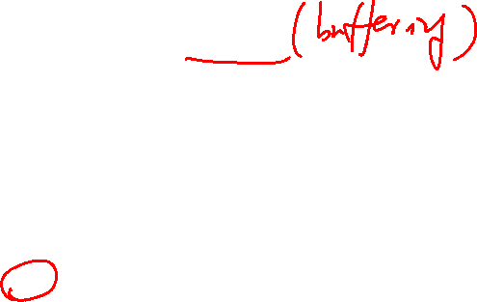
Stream vs array
Streams provide means for our program to input or output data
What is the major difference between a stream and an array
stream is faster than arrays
stream uses less space than arrays
stream doesn’t allow random access while arrays can
None of the above

Slide 6
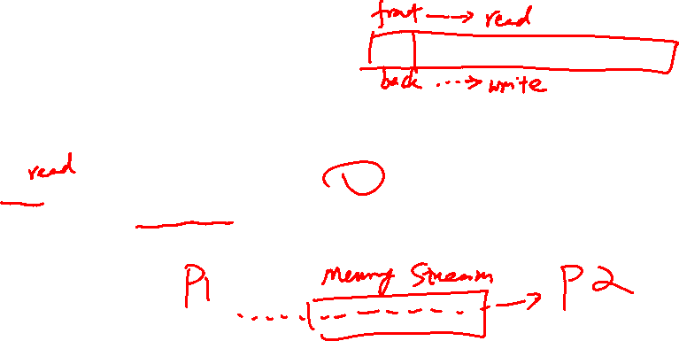
Memory Stream
A stream that stores input or output in a buffer in memory
No random access
public void write(E data) {
this.contents[this.back]= data;
this.back++;
}
public E next() {
E temp = this.contents[this.front];
this.front++;
return temp;
}
Initially, front and back are both 0
Whose index is front?
the element to be read
the location to be written into
A and B can be both be true under certain situation

Slide 7
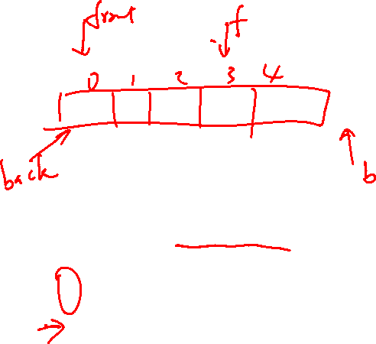
Memory Stream
A stream that stores input or output in a buffer in memory
No random access
public void write(E data) {
this.contents[this.back]= data;
this.back++;
}
public E next() {
E temp = this.contents[this.front];
this.front++;
return temp;
}
Initially, front and back are both 0 and the
capacity is 5.
Which of the following front/back pairs
will result in a buffer overflow for write?
3/4
4/5
3/5
More than one of them
None of the them

Slide 8
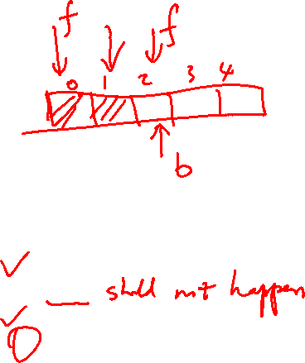
Memory Stream
A stream that stores input or output in a buffer in memory
No random access
public void write(E data) {
this.contents[this.back]= data;
this.back++;
}
public E next() {
E temp = this.contents[this.front];
this.front++;
return temp;
}
Initially, front and back are both 0 and the
capacity is 5.
Which of the following front/back pairs
will result in a buffer underflow for next?
4/4
4/3
2/2
More than one of them
None of the them

Slide 9
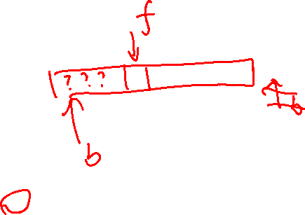
Memory Stream
A stream that stores input or output in a buffer in memory
No random access
public void write(E data) {
this.contents[this.back]= data;
this.back++;
}
public E next() {
E temp = this.contents[this.front];
this.front++;
return temp;
}
What data structure is our memory stream
similar to?
stack
queue
linked list
BST
None of the above

Slide 10
MemoryStream
Convert array to circular array list
How does this impact our implementation of the memory stream

